Slide 1
IRIS DATA CLASSIFICATION USING SVM
GUIDE
Prof. S. R. Nalamwar
PRESENTED BY
Sarthak Nilesh Thorat
Suraj Nandlal Shirude
Hitesh Pankaj Saswadkar
Pratik Rajendra Karhekar
Vishal Dadasaheb Tanawade

Slide 2
INTRODUCTION
Machine learning (ML) and deep learning (DL) are AI fields that have exploded in popularity in molecular biology.
In all levels of cellular systems science, the key challenges are provided in terms of how to analyse large datasets and extract new information.
Support Vector Machine(SVM) is a supervised machine learning algorithm used for both classification and regression

Slide 3
PROBLEM STATEMENT
Classify the Iris Flower Dataset using Support Vector Machine.

Slide 4
OBJECTIVE
Classify Iris Flower Dataset.
To learn about Support Vector Machine.

Slide 5
Software Requirement
Jupyter Notebook
Python
Sklearn, Pandas, Numpy, MatplotLib and Seaborn libraries .

Slide 6
METHODOLOGY
1. Load the data 2. Analyze the dataset 3. Model training. 4. Model Evaluation. 5. Testing the model.

Slide 7
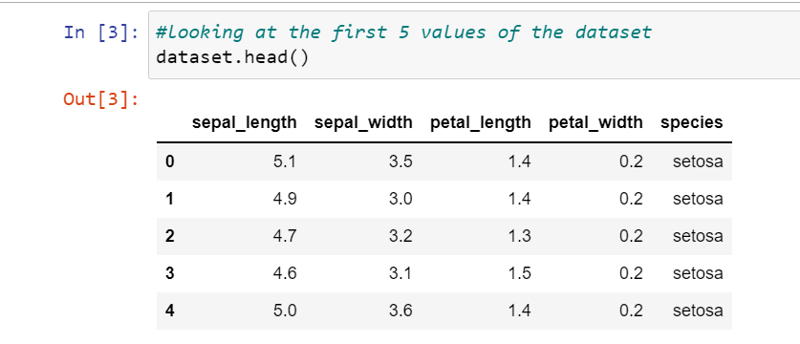
DATASETS CLASSES
Iris Flower contains following 3 classes:
1.Iris Versicolor
2.Iris Setosa
3.Iris Virginica.

Slide 8
SUPPORT VECTOR MACHINE(SVM)
Support Vector Machine(SVM) is a supervised machine learning algorithm used for both classification and regression.
However, primarily, it is used for Classification problems in Machine Learning .
The goal of the SVM algorithm is to create the best line or decision boundary that can segregate n-dimensional space into classes so that we can easily put the new data point in the correct category in the future.
This best decision boundary is called a hyperplane.

Slide 9
SVM
Support Vectors:
The data points or vectors that are the closest to the hyperplane and which affect the position of the hyperplane are termed as Support Vector. Since these vectors support the hyperplane, hence called a Support vector.
Hyperplane:
There can be multiple lines/decision boundaries to segregate the classes in n-dimensional space, but we need to find out the best decision boundary that helps to classify the data points. This best boundary is known as the hyperplane of SVM.

Slide 10
Linear Kernel
Linear Kernel is used when the data is Linearly separable, that is, it can be separated using a single Line. It is one of the most common kernels to be used. It is mostly used when there are a Large number of Features in a particular Data Set.
One of the examples where there are a lot of features, is Text Classification, as each alphabet is a new feature. So we mostly use Linear Kernel in Text Classification.

Slide 11
Polynomial Kernel
It represents the similarity of vectors in the training set of data in a feature space over polynomials of the original variables used in the kernel.
the polynomial kernel looks not only at the given features of input samples to determine their similarity, but also combinations of these.
In the context of regression analysis, such combinations are known as interaction features.

Slide 12
Advantages of SVM
Effective in high dimensional cases
Its memory efficient as it uses a subset of training points in the decision function called support vectors
Different kernel functions can be specified for the decision functions and its possible to specify custom kernels

Slide 13
APPLICATIONS
Face detection – SVM classify parts of the image as a face and non-face and create a square boundary around the face.
Classification of images – Use of SVMs provides better search accuracy for image classification. It provides better accuracy in comparison to the traditional query-based searching techniques.
Handwriting recognition – We use SVMs to recognize handwritten characters used widely.

Slide 14
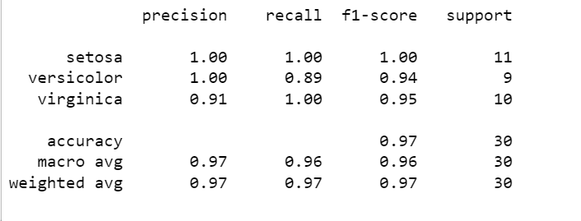
Classification Report (Linear Kernel)

Slide 15
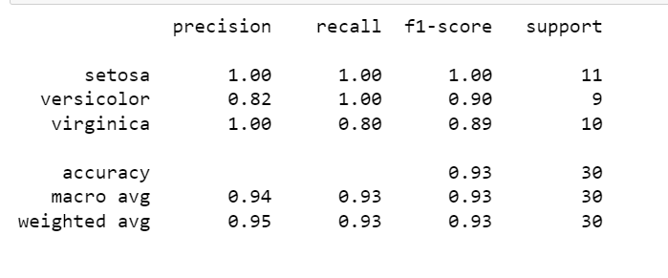
Classification Report (Polynomial Kernel)

Slide 16
THANK YOU

